Slide 1
The Normal Distribution & Checking for Normality

Slide 2
Continuous Distributions
Continuous distributions are constructed from continuous random variables in which values are taken for every point over a given interval
With continuous distributions, probabilities of outcomes occurring between particular points are determined by calculating the area under the curve between these points
2

Slide 3
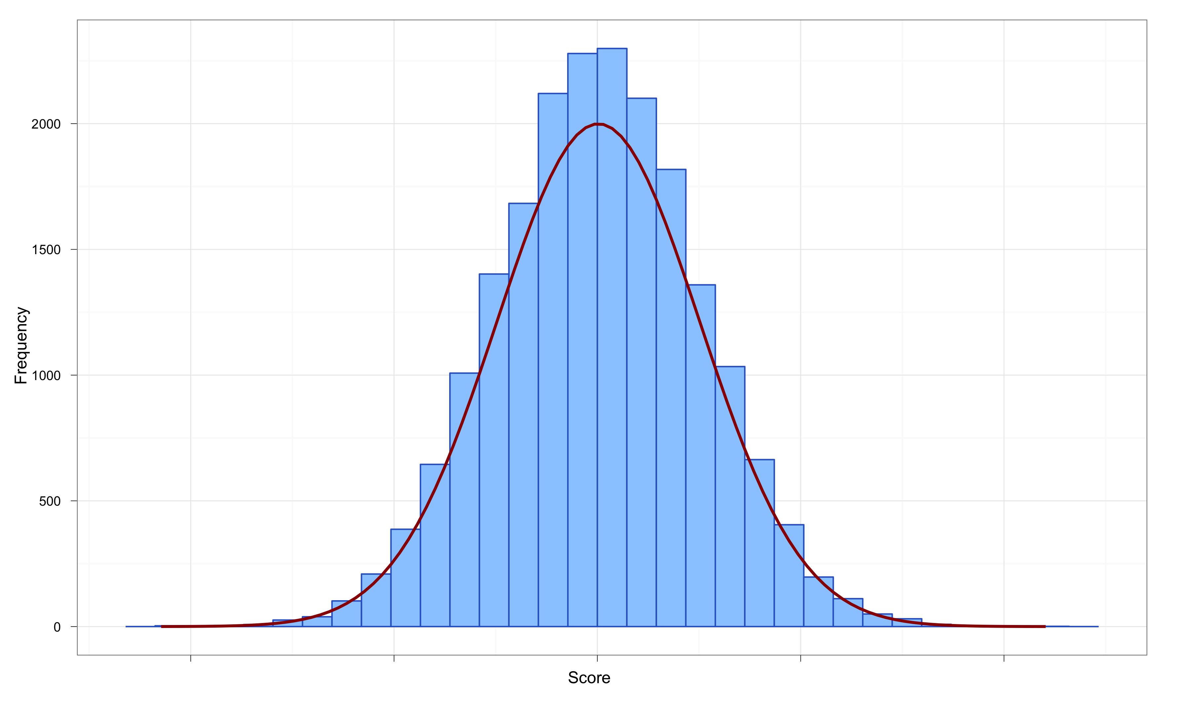
The Normal Distribution
The Normal distribution is found to be a suitable model for many naturally occurring variables which tend to be symmetrically distributed about a central modal value - the mean.
e.g. human heights, weights, IQs etc. and also the output from many production processes,
Normal distribution is characterized by the mean and the Standard deviation
Ability to put a particular score into perspective
How many standard deviations above/below the mean?

Slide 4
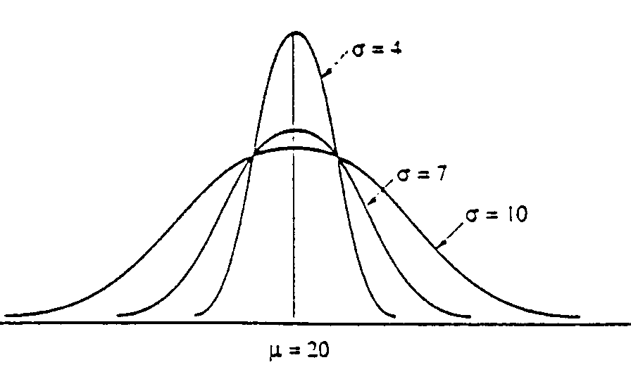
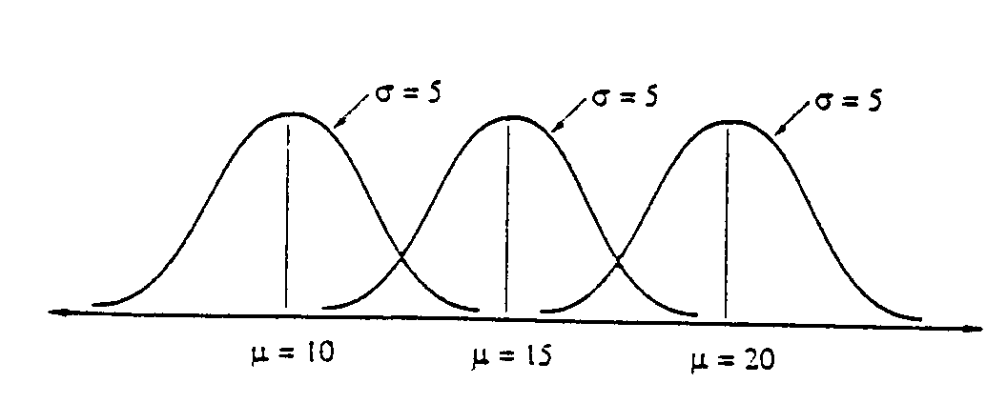
There is no single normal curve, but a family of curves, each one defined by its mean, µ, and standard deviation, σ; µ and σ are called the parameters of the distribution.
As we can see the curves may have different centres and/or different spreads but they all certain characteristics in common:
The curve is bell-shaped,
it is symmetrical about the mean ( µ ),
the mean, mode and median coincide.

Slide 5
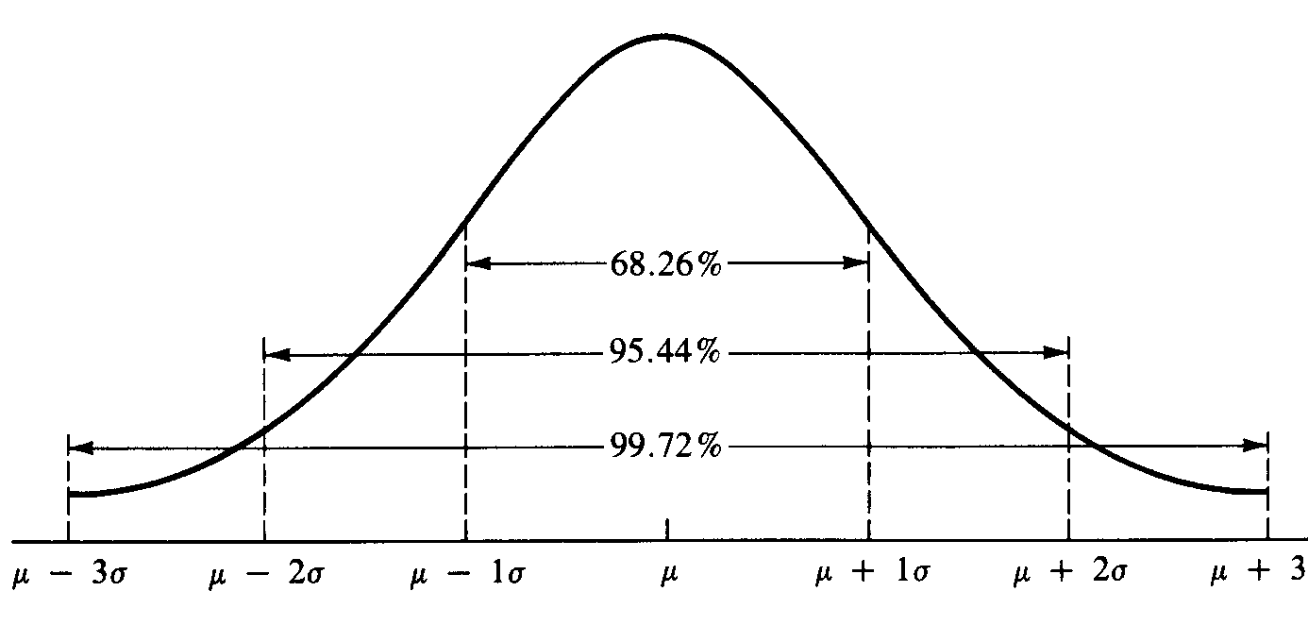
Area beneath the Normal Distribution Curve No matter what the values of µ and σ are for a normal probability distribution, the total area under the curve is equal to one.
We can therefore consider partial areas under the curve as representing probabilities. The partial area between a stated number of standard deviation below and above the mean is always the same, as illustrated below
N.B. The curve neither finishes nor meets the horizontal axis at μ ± 3σ, it only approaches it and actually goes on indefinitely.

Slide 6
Shape of probability distributions
Symmetrical – the right half is a mirror image of the left half
Skewness – shows that the distribution lacks symmetry; used to denote the data is sparse at one end, and piled at the other end
Absence of symmetry
Extreme values in one side of a distribution
The shape of probability distributions can be very important in statistical analysis
Scores often only approximate a normal distribution
Skewness and Kurtosis are two measures of how scores may deviate from the perfectly normal distribution

Slide 7
Skewness
Skew implies that the shape of a unimodal distribution is asymmetric about its mean -the mean lies towards the direction of the skew (the longer tail) relative to the median
Positive skew – scores are shifted towards the left – in a positively skewed distribution there tend to be some positive outliers
Negative skew – scores are shifted towards the right

Slide 8
Skewness
Mean
Mode
Mean
Median
Mode
Mode
Mean
Median
Median
Negatively
Skewed
Symmetric
(Not Skewed)
Positively
Skewed

Slide 9
Coefficient of Skewness
Coefficient of Skewness (S_{k}) - compares the mean and median in light of the magnitude to the standard deviation; M_{d} is the median; σ is the Std Dev
If S_{k} < 0, the distribution is negatively skewed (skewed to the left).
If S_{k} = 0, the distribution is symmetric (not skewed).
If S_{k} > 0, the distribution is positively skewed (skewed to the right).
Notes:
49

Slide 10
Kurtosis
Peakedness of a distribution
Leptokurtic: high and thin
Mesokurtic: normal in shape
Platykurtic: flat and spread out
Leptokurtic
Mesokurtic
Platykurtic

Slide 11
Testing for Normality (or approximate Normality
Visual inspection of Histograms, Box Plots, Q-Q Plots etc
Values for Skewness & Kurtosis
Sometimes transformations can correct for skew and kurtosis
Square root of raw scores
Inverse (1/x) of raw scores
Base 10 Log of raw scores
Kolmogorov-Smirnov Test / Shapiro-Wilk Test / Anderson Darling Test and others
Large samples (200+) can offset concerns
Multivariate outliers - Check Mahalanobis distances
Winsorizing (trimming) extreme outliers (say z score ≥ 3.0) may be appropriate

Slide 12
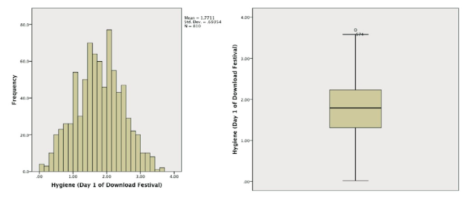
Check Histograms & Box Plots

Slide 13
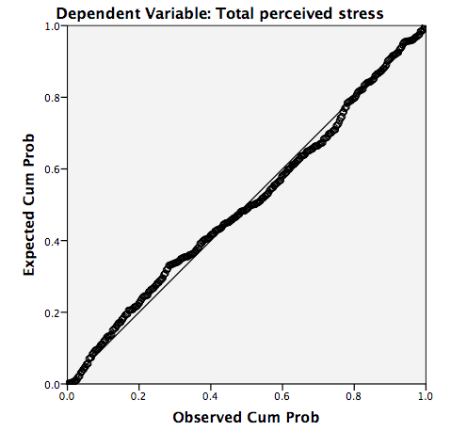
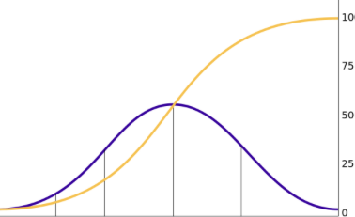
Check Q-Q (quantile–quantile) plot
Plots the quantiles of the data.
The expected quantiles are a straight diagonal line, whereas the observed quantiles are plotted as individual points.
Deviation of the dots from the diagonal line represents a deviation from normality.

Slide 14
P-P plot
The P-P plot (probability–probability plot) is another useful graph for checking normality; it plots the cumulative probability of a variable against the cumulative probability of a particular distribution (in this case we would specify a normal distribution).
P-P plots can be interpreted in the same way as Q-Q plots
If you have a lot of scores, Q-Q plots can be easier to interpret than P-P plots because they will display fewer values

Slide 15
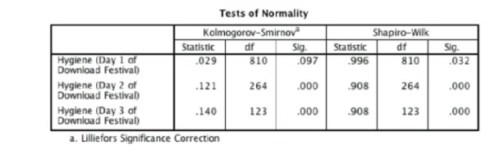
Kolmogorov-Smirnov Test
The Kolmogorov-Smirnov test can be used to see if a distribution of scores significantly differs from a normal distribution.
If the K-S test is significant (Sig. is less than .05) then the scores are significantly different from a normal distribution. Otherwise, scores are approximately normally distributed.

Slide 16
Shapiro-Wilk Test
The Shapiro–Wilk test does much the same thing, but it has more power to detect differences from normality (so this test might be significant when the K-S test is not).
In large samples these tests can be significant even when the scores are only slightly different from a normal distribution. -they should always be interpreted in conjunction with histograms, P-P or Q-Q plots, and the values of skew and kurtosis.

Slide 17
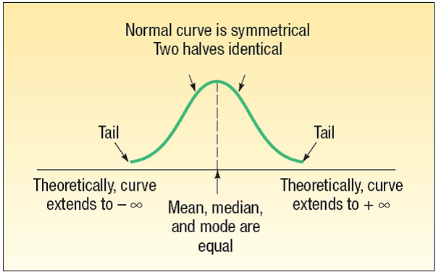
The Normal Distribution – Graphically

Slide 18

The Standard Normal Probability Distribution
The standard normal distribution is a normal distribution with a mean of 0 and a standard deviation of 1.
It is also called the z distribution.
A z-value is the signed distance between a selected value, designated X, and the population mean μ, divided by the population standard deviation, σ.
Z score – represents the number of Std Dev a value (x) is above or below the mean of a set of numbers when the data are normally distributed
Z score allows translation of a value’s raw distance from the mean into units of std. dev.

Slide 19
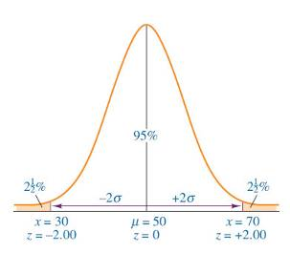
Z Scores: An example
A dataset is normally distributed with a mean of 50 and standard deviation of 10. Determine the z score for a value of 70
70 50
-
z
=
=
2.0
10

Slide 20
Finding Probabilities under a Normal Curve
The steps in the procedure are:
Draw a sketch of the situation,
standardise the value of interest,
use the standard tables to find its associated area under the curve,
if necessary, combine this area found with another to give the required area,

Slide 21
Example: A variety of questions about the spending habits of Supermarket shoppers can be answered given the information that: μ = £50.00 σ = £15.00 n = 500
Probability of a shopper spending over £80.
We need P(x > £80), i.e.the probability that a customer spends over £80
μ = £50.00
σ = £15.00
x = £80
Standardise x:
From tables:
Therefore: P(x > £80) = 0.5 - 0.4772 = 0.0228

Slide 22
Probability that a shopper spends between £30 and £80, i.e. P(£30 < x < £80)
μ = £50.00 σ = £15.00
x₁ = £30 x₂ = £80
P(50 < x < 80)
From (a) x = 80 Q1 = 0.4772
P(50 < x < 80)
(The table values are all positive, so when z is negative we invoke the symmetry of the situation and use its absolute value.)
From tables: z = -1.333  Q₂ = 0.4088
Therefore: P(£30 < x < £80) = 0.4772 + 0.4088 = 0.8860
The percentage of shoppers who spend between £30 and £80 is: 88.6%

Slide 23
% expected to spend between £55 & £70 We first need P(£55 < x < £70), then we convert the probability to a percentage.
μ = £50, σ = £70
x₁ = £30, x₂ = £70
We need Q_{1,} (£50 to £70), minus Q_{2,} (£50 to £55)
P(£50 < x < £55)
From tables z₁ = 1.333 Q₁ = 0.4088
P(£50 < x < £70 )
From tables z₂ = 0.333  Q₂ = 0.1305
Therefore: P(£55 < x < £70) = Q₁ – Q₂ = 0.4088 – 0.1305 = 0.2783
% of shoppers between £55 and £70 = 27.8%

Slide 24
Finding Values from Given Proportions The value below which 70% of the shoppers are expected to spend
μ = £50, σ = £15, x = £?
70% below x ⇒ 20% between μ and x
20% ⇒ Q = 0.2000
From tables if Q = 0.2000 ⇒ z = 0.524
Using standardising formula:
15 x 0.524 = x – 50 7.86 = x – 50
7.86 + 50 = x x = £57.86
The value below which 70% of customers spend is £57.88
0.5 Q=0.2

Slide 25
Empirical Rule: Example
Assume that petrol prices in the United Kingdom are normally distributed with a mean of £1.30 with a standard deviation of £0.08.
According to the empirical rule approximately 68% of prices should fall within £1.22 and £1.38, 95% of prices should fall within £1.14 and £1.46, and nearly all (99.7%) should fall within £1.06 and £1.54.
£1.22 £1.30 £1.38
µ = £1.30
σ = £0.08
£1.22 £1.30 £1.38
µ = £1.30
σ = £0.08

Slide 26
The Normal Distribution Checking for Normality

